Slide 1
My pa experience
Chandler Smith, PA-C, MPAS

Slide 2
About me
I grew up in Gainesville, FL
I love Gator Football
I have an extremely cute four-legged child named Murphey
I wanted to be in medicine for as long as I can remember
I’m an ordained minister

Slide 3
Stats
University of Florida Bachelor of Health Science – c/o 2016
3.67 GPA
Patient Care Experience Hours: >2000
Shadowing hours ~ 100
I can’t find my GRE scores anywhere

Slide 4
Extracurriculars
Summer Camp Counselor
Volunteer at Treehouse Kidz
Member of Delta Zeta Sorority
Sisterhood chair, New Member Education Assistant
Panhellenic Council
Pi Chi 2014
Executive Board - Communications Vice President 2015
Greek Advance Leadership Development Facilitator
Dance Marathon Merchandise Captain

Slide 5
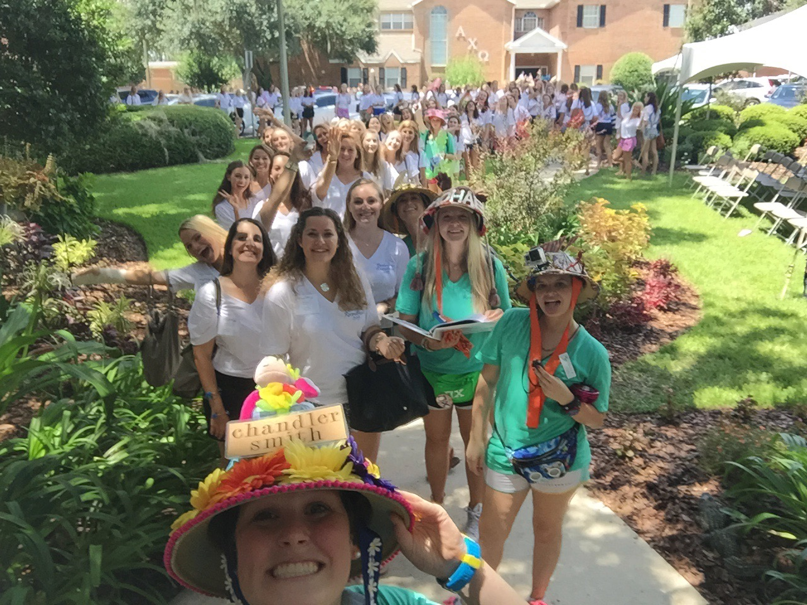
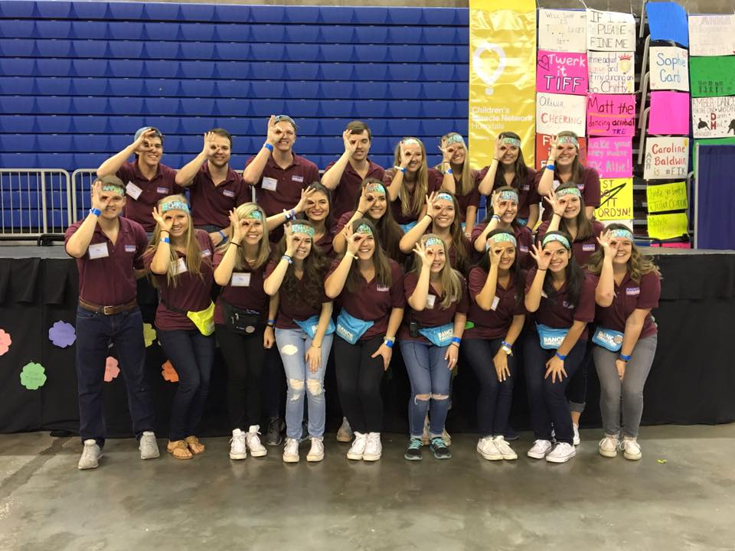
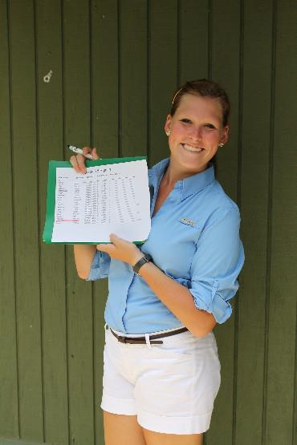

Slide 6
Patient Care Experience
PCA at Shands on Unit 54 -> 66 Cardiac Med Surg (2016-2018)
Excellent hands on experience
Developed a bedside manner
Became familiar with hospital setting
Observed the role of a PA in a multidisciplinary healthcare team setting
Eventually responsible for training new PCAs
Member of Multiple Unit Performance Improvement Teams
I would highly recommend being a PCA for some part of your patient care experience. Not a glamorous or easy job but I felt 100% comfortable walking into a hospital and interacting with sick patients.

Slide 7
Shadowing
I took a class one summer in undergrad where I was matched with a physician who I shadowed for the summer (and got academic credit for it!)
Sports Medicine/Ortho
Cardiovascular Surgery
Heart Failure

Slide 8
Why PA?
Lateral mobility
I get to work as a part of a team as opposed to working by myself
Lifelong learning
I am an active part of a patient’s diagnosis and treatment
Patients can be a puzzle
My days are never boring

Slide 9
Applying to PA school
Applied to 12 Schools
Offered to interview at 7 schools, accepted interview at 5 of the 7
Rejected without interview – 4 schools
Offered admission after interview – 4
Waitlisted after interview – 1
Ghosted by 1 school
Final Decision – University of Florida School of Physician Assistant Studies
Go Gators!

Slide 10
What drew me to UF’s PA school
Interview dinner with current students
Pass/fail grading
Reputation and established program history
24 month program
Ability to do clinical rotations outside of Gainesville
PANCE pass rates
Price

Slide 11
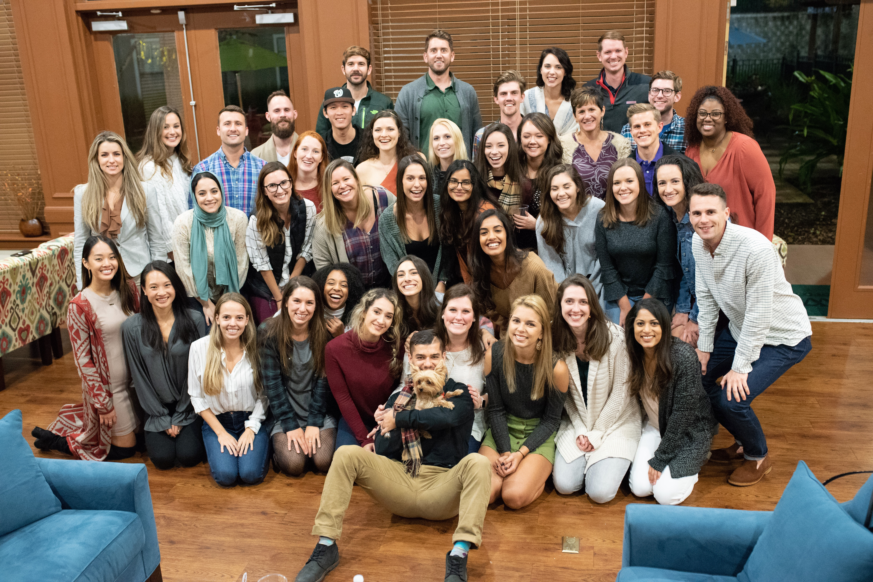

Slide 12
My career as a PA
I entered PA school dead set on becoming a Pediatric Primary Care PA
I did my clinical rotations in Jax/Gainesville
I graduated at the beginning of the COVID pandemic in June 2020
I knew from my clinical rotations that I enjoyed hospital medicine the most – primarily Critical Care Medicine and Emergency Medicine
Accepted a job in the Burn/ENT/PRS Surgical ICU

Slide 13
Role as a CCM PA
Manage Burn/ENT/PRS surgical patients
Evaluate patients and develop a plan for their care based on clinical exam, lab values, vital signs, imaging, etc.
Prescribe treatments based off of my evaluation of and plan for the patient
Daily rounding with a multidisciplinary team
Perform procedures – CVLs, arterial lines, bedside ultrasounds, bronchoscopies, intubations, chest tubes
Respond to acute changes in patient condition
Communicate constantly with attendings, nurses, therapists, family members
3 12 hour shifts a week

Slide 14
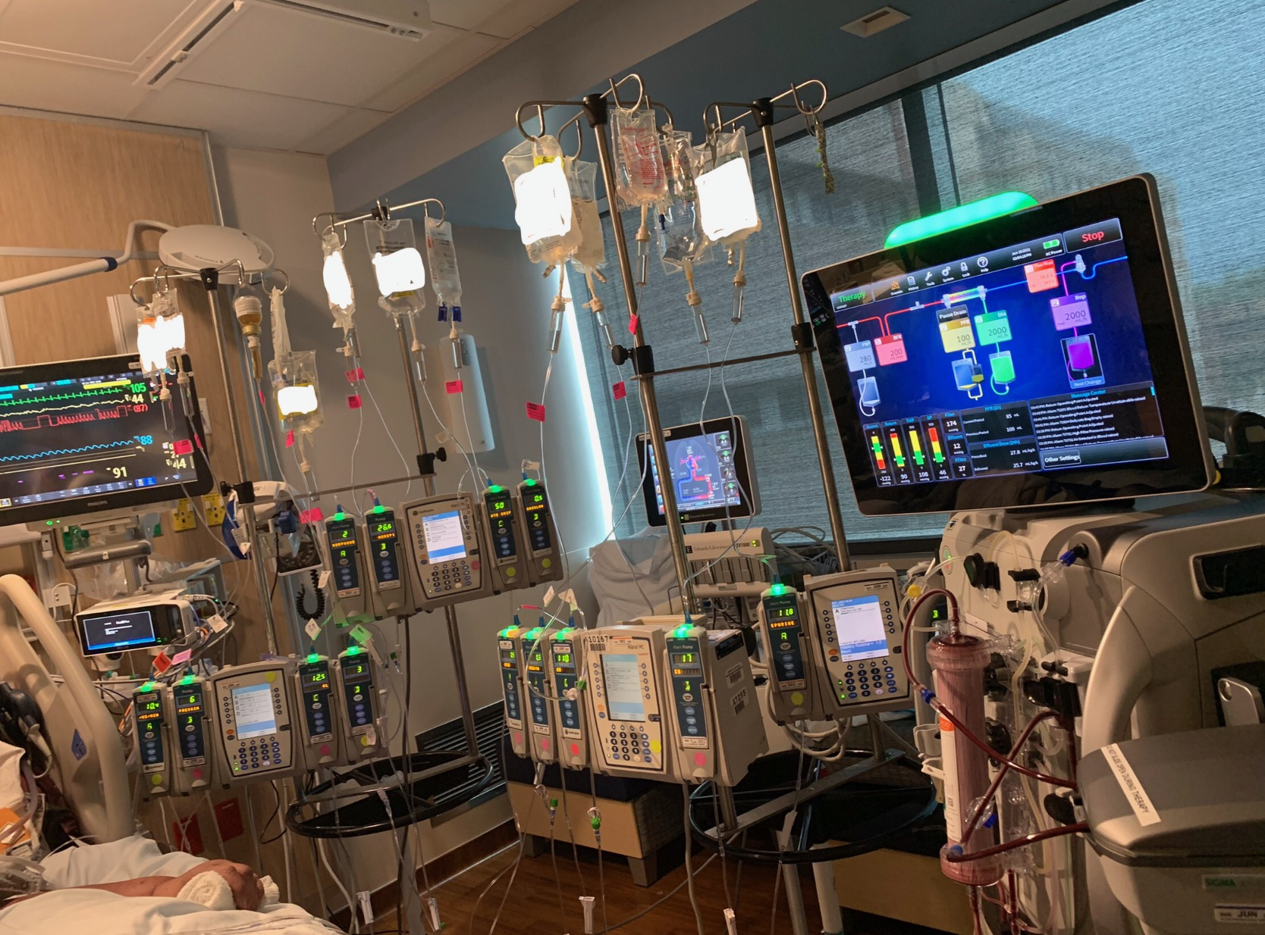

Slide 15
Advice
Find something you enjoy or are passionate about and develop yourself whether it be advancing a skill or becoming a better leader
In your interview/Personal Statement, remember that most people going into medicine want to “help people.” Describe the reason why the PA profession is the way you want to “help people.” Expand on how your extracurriculars or life experiences can translate to the PA profession.
Each of you is unique and will contribute to the medical field in some way, so exploit that! Brag about what makes you special.
Enjoy your undergrad experience!!

Slide 16
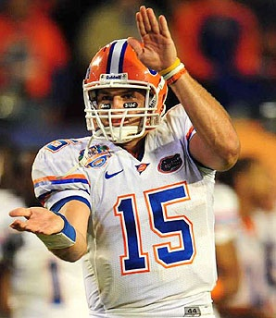
Thanks and GO Gators!

